Slide 1
D28 CEC MEETING May 2, 2024 Superintendent : Dr. Eric L. Blake Deputy Superintendent: Dr. Shonelle Hall
“With effort and support all schools can meet the needs of their students and help them achieve outstanding educational outcomes.”

Slide 2
Community School District 28
Vision
In Community School District 28 we celebrate our differences because we understand that woven into those differences is the knowledge that they offer us unlimited possibility to learn and expand our knowledge of and commitment to all humanity. We are beautifully diverse, coming from countless racial, ethnic, language, and belief backgrounds. We commit to striving for inestimable contribution to the lives of our scholars.
Mission
In Community School District 28 we focus on equity as a lever for achievement for every single scholar. We are a district of excellence. We commit to every school maintaining high academic standard and working closely with families so that all scholars are learning at high levels. We also commit to being a district of learners ensuring that we promote critical thinking rooted in core content conceptual understanding through creative problem solving, technology innovation, social emotional learning, and community advocacy.

Slide 3
LEAPS GRANT:
New - New Yorkers & Students In Temporary Housing
Partnership with Community Mediation Services.
Focus on STEAM enrichment and education.
Submitted for review and approval.
We will be informed at the end of June.
We are also in the process of applying for a 2nd Special Education grant. We will update everyone once it’s been submitted.

Slide 4
2024-2025 Comprehensive Education Plans
Leaders are working on developing their initial 2024-2025 Comprehensive Education Plan. The focus points of the plan is around: Math, ELA, SWDs, MLLs/ELLs, Attendance, and Parent Engagement.
Feedback and support will be provided to our leaders during this process.

Slide 5
Overall Attendance Mid Year Goal: 91.4%
Chronic absenteeism Mid Year Goal: 32%
Where are we Now:
YTD Overall Attendance: 90.8% vs Citywide 89.7% (ABOVE THE CITY AVERAGE)
April 23/23 was 90.5%
Chronic Absenteeism YTD: 33.2% compared to 37% last year, a significant improvement.
*Both metrics have improved year over year, and we are moving in the right direction.
We are also trending upwards in the number of new- New Yorkers entering District 28. We are currently at 21, 828.
DCEP Goals:

Slide 6
Summer Rising
We are fully staffed at leadership positions, Principal In Charge, as well as Site Supervisors.
Leaders are currently working on notifying families of offers and wait-list positions.
(New) Each site will have a transportation coordinator to support with bussing.
We anticipate having a representative from Enrollment and Office of Pupil Transportation for June’s CEC meeting.

Slide 7
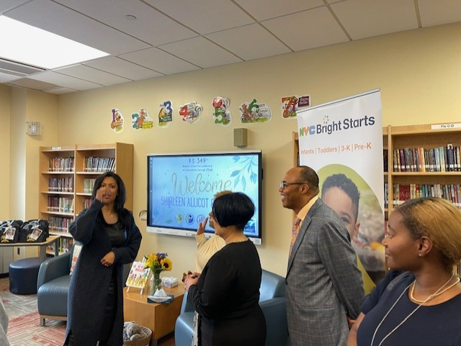
ABC 7, in partnership with the New York City Department of Education, and NYC Reads, visited P.S. 349 –Magnet School for Leadership Excellence, as part of the Disney Magic of Storytelling campaign. Anchor, Shirleen Allicot, read stories to a very excited audience! Dr. Kara Ahmed, Deputy Chancellor of Early Childhood Education was also in attendance. The students thoroughly enjoyed a “celebrity” reading to them and of course, being on Eyewitness News!

Slide 8
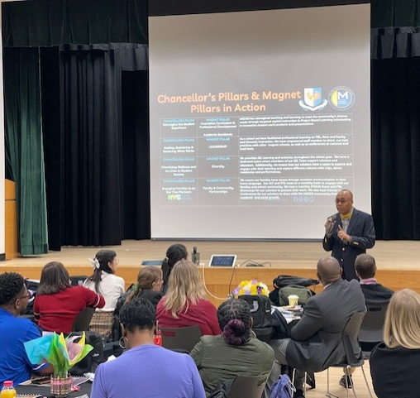
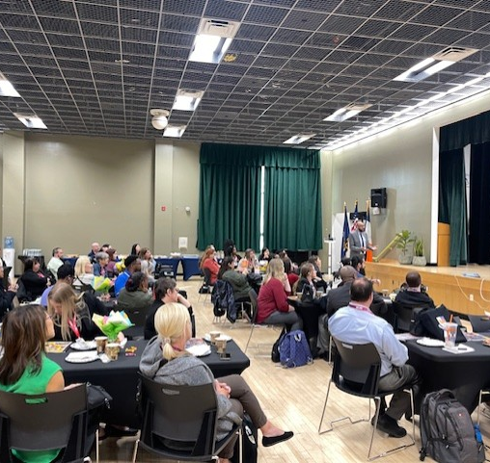
MAGNET SCHOOLS VISIT
We are shouting out and thanking Principals Bates-Howell (349), Branker (40), Cespedes (312), Elkarany (358) and Honore (55) for hosting the Magnet Schools visit and representing us as a district in the greatest light! 🎉 I would also like to congratulate Principal Bates-Howell on becoming Region 1 Magnet Schools of America, Principal of the Year!☺☺☺

Slide 9
We currently have over 300 applicants who have registered. All our schools will also have representatives at the Hiring Fair.

Slide 10
REMINDER
State Assessments:
Math State Exams:
Initial Computer Based Testing (CBT) Window Opens
From May 7 – 17th
NYSESLAT
(Group administration) Beginning 3rd week of May – June

Slide 11
Nine CSD 28 educators earned the distinction of being selected as Big Apple Award and Fellowship Semi-Finalists this year: Aziza Adams (28Q048), Tara Cannon (28Q072), Janet Geier (28Q101), Christine Tobia (28Q121), Yerlina Almonte (28Q139), Aaron Lober (28Q157), Stacy Helman (28Q196), Debra Robinson (28Q206), Jennifer Rivera (28Q217).
SHOUT
OUTS!

